Slide 1
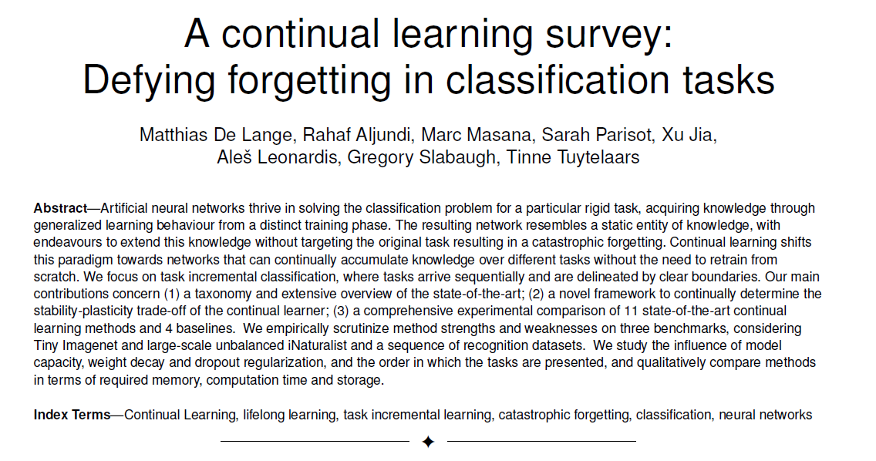
Notes:
Tom
Present authors, date, and general subject of the paper.
This article has been published in 2019, at the conference IEEE , for the track : transactions on pattern analysis and machine intelligence.
This article is a large survey on methods developped for image classification in a task incremental continual learning framework.

Slide 2
Paper's Objectives
Establish a taxonomy for continuous learning
Establish a Framework to compare continual learners
Comprehensive experimental comparison of continual learning
methods
Notes:
1. Establish a taxonomy for continuous learning. In other words, they classify different methods to address CL problems.
2. Establish a Framework to determine the stability-plasticity hyper parameters of real-world continual learners without violating the continual learning setting.
Therefore, fairly comparing continual learners in a true continual learning setting.
3. Comprehensive experimental comparison of 11 state-of-the-art continual learning methods and 4 baselines

Slide 3
Table of contents :
Introduction
Continual Learning Setting
Hyperparameter Framework
Different CL approaches :
Replay methods :
Regularization-based methods
Parameter isolation-based methods
Experiments and Discussion
Conclusion

Slide 4
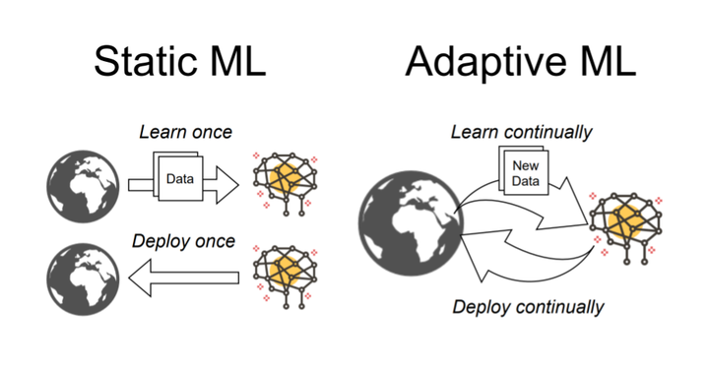
Continual Learning
Studies how to learn tasks sequentially without forgetting knowledge acquired
Notes:
You guessed it, todays topic at hand will be continual learning.
Continual Learning is the field that studies the problem of learning from an infinite amount of data with the goal of gradually extending acquired knowledge and using it for future learning.
The end goal is to have a system that interacts with an infinite stream of data and learns from it by getting better at new tasks as well as old ones. Ideally we would have both (positive) backward and forward transfer.

Slide 5
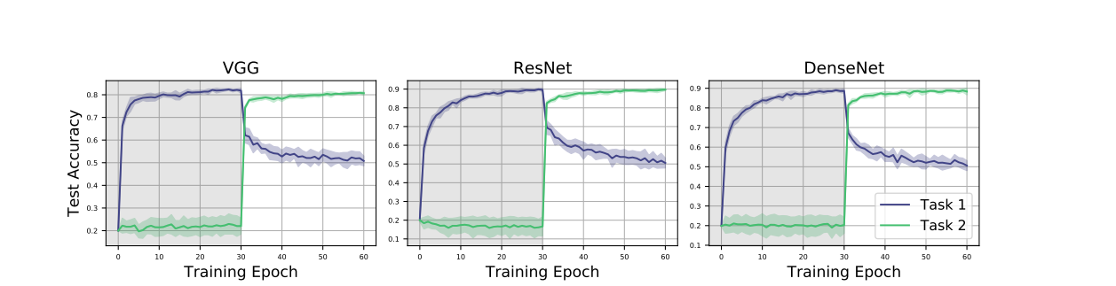
Stability vs Plasticity: Catastrophic forgetting
Image credit to Ramasesh et al., Anatomy of Catastrophic Forgetting
Notes:
As we all should know by now, a major challenge of continual learning is catastrophic forgetting. It is the phenomenon where performance on a previously learned task or domain significantly degrades over time as new tasks or domains are added.
This is showcased by the example below.
VGG, ResNet and DesneNet were trained on CIFAR-10 that was split between 2 sequential tasks of 5 classes each.
At epoch 30, a new task is introduced. We observe an immediate decrease in the performance of task one for all network compared to a rapid increase in performance for the new task at hand.
This is a direct result of a more general problem in neural networks, namely the stability-plasticity dilemma [20], with plasticity referring to the ability of integrating new knowledge, and stability retaining previous knowledge while encoding it. Right we here we have an example of networks with good plasticity, but bad stability.

Slide 6


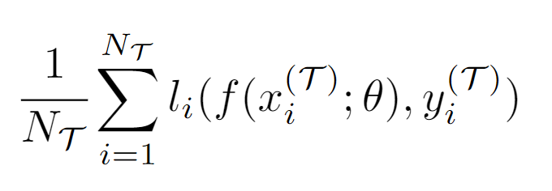
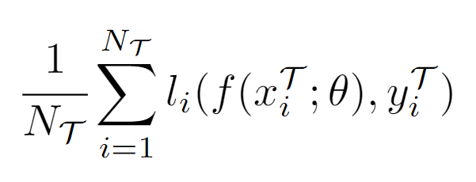
Continual Learning Setting
Concept of tasks
Each task t has its labeled data
We minimize the empirical risk or
Notes:
Quick recap on the Continual Learning Setting for supervised classification,
Data is assigned to tasks that are isolated in the training phase with a new batch of data, belonging to a new group of classes, a new domain, or a different output space. When training on a particular task, the model should not have access to data from previous tasks.
The objective being to minimize the sum of the losses over each task. Shout-out to Optimization and Generalization of Regularization-Based Continual Learning: a Loss Approximation Viewpoint, approximates previous losses with the second-order Taylor expansion based on previously stored weights for each task.

Slide 7




Continual Learning Setting
Class incremental
Task incremental
Incremental domain
Data incremental
Notes:
Quick recap on the Continual Learning Setting for supervised classification, Continual Unsupervised Representation Learning
Class incremental bascially adds classes sequentially to the already existing classes from previous task
Task incremental, Classes are different for each task
Incremental domain, Same classes, different domains for X
Data incremental, is a more general setting. We define data streams without the notions of task, class or domain.

Slide 8
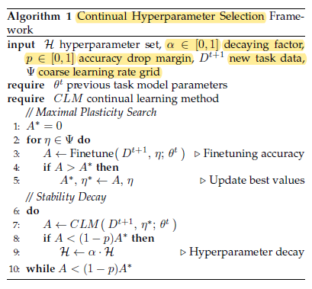
Hyperparameter Framework
Image credits to De Lange et al., A continual learning survey
Notes:
As said previously, one of the main objectives of the paper is to provide a fair comparison between different continual learning methods with its framework.
It sets hyperparameters without violating the continual learning setting that is models have no access to previous task data. It is a more realistic approach compared to grid search on hyperparameters, using held-out validation data from all tasks.
That being said, their algorithm has two main phases:
1. Trains a copy of the network with previous model parameters on a new task in order to achieve maximum accuracy. It finds the best accuracy achievable A* by the model on the new task.
2. Trains a copy of the network with previous model parameters on a new task. It's objective is to achieve an accuracy of (1-p)A*
P and alpha are to hyper parameters of the framework. The set of hyperparameters H is related to forgetting, it should be identified for the continual learning method. Psi is the

Slide 9
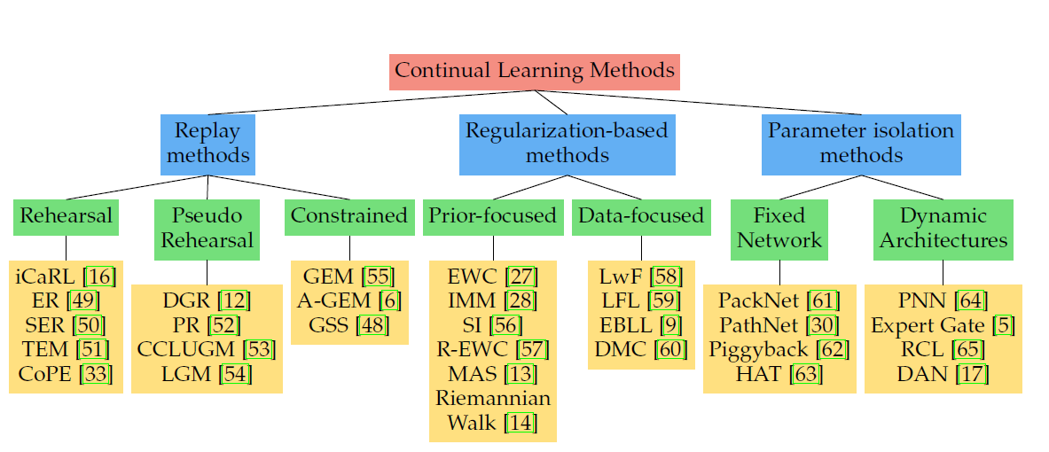
Different CL approaches :
Credit to De Lange et Al., « A continual learning survey: Defying forgetting in classification tasks »
Notes:
Won’t spend time on describing each methods, but briefly recapt heir core differences.
This scheme has already been introduced previously by Irina, hence we will try not to repeat was has already been said by Irina during the introductive lecture but rather spend time on some interesting point of dicussion in this article .
Here are the 11 models part of the study. As you can see, dynamics Architectures won’t be developed in this review as no model involved in the study relies on this method.

Slide 10
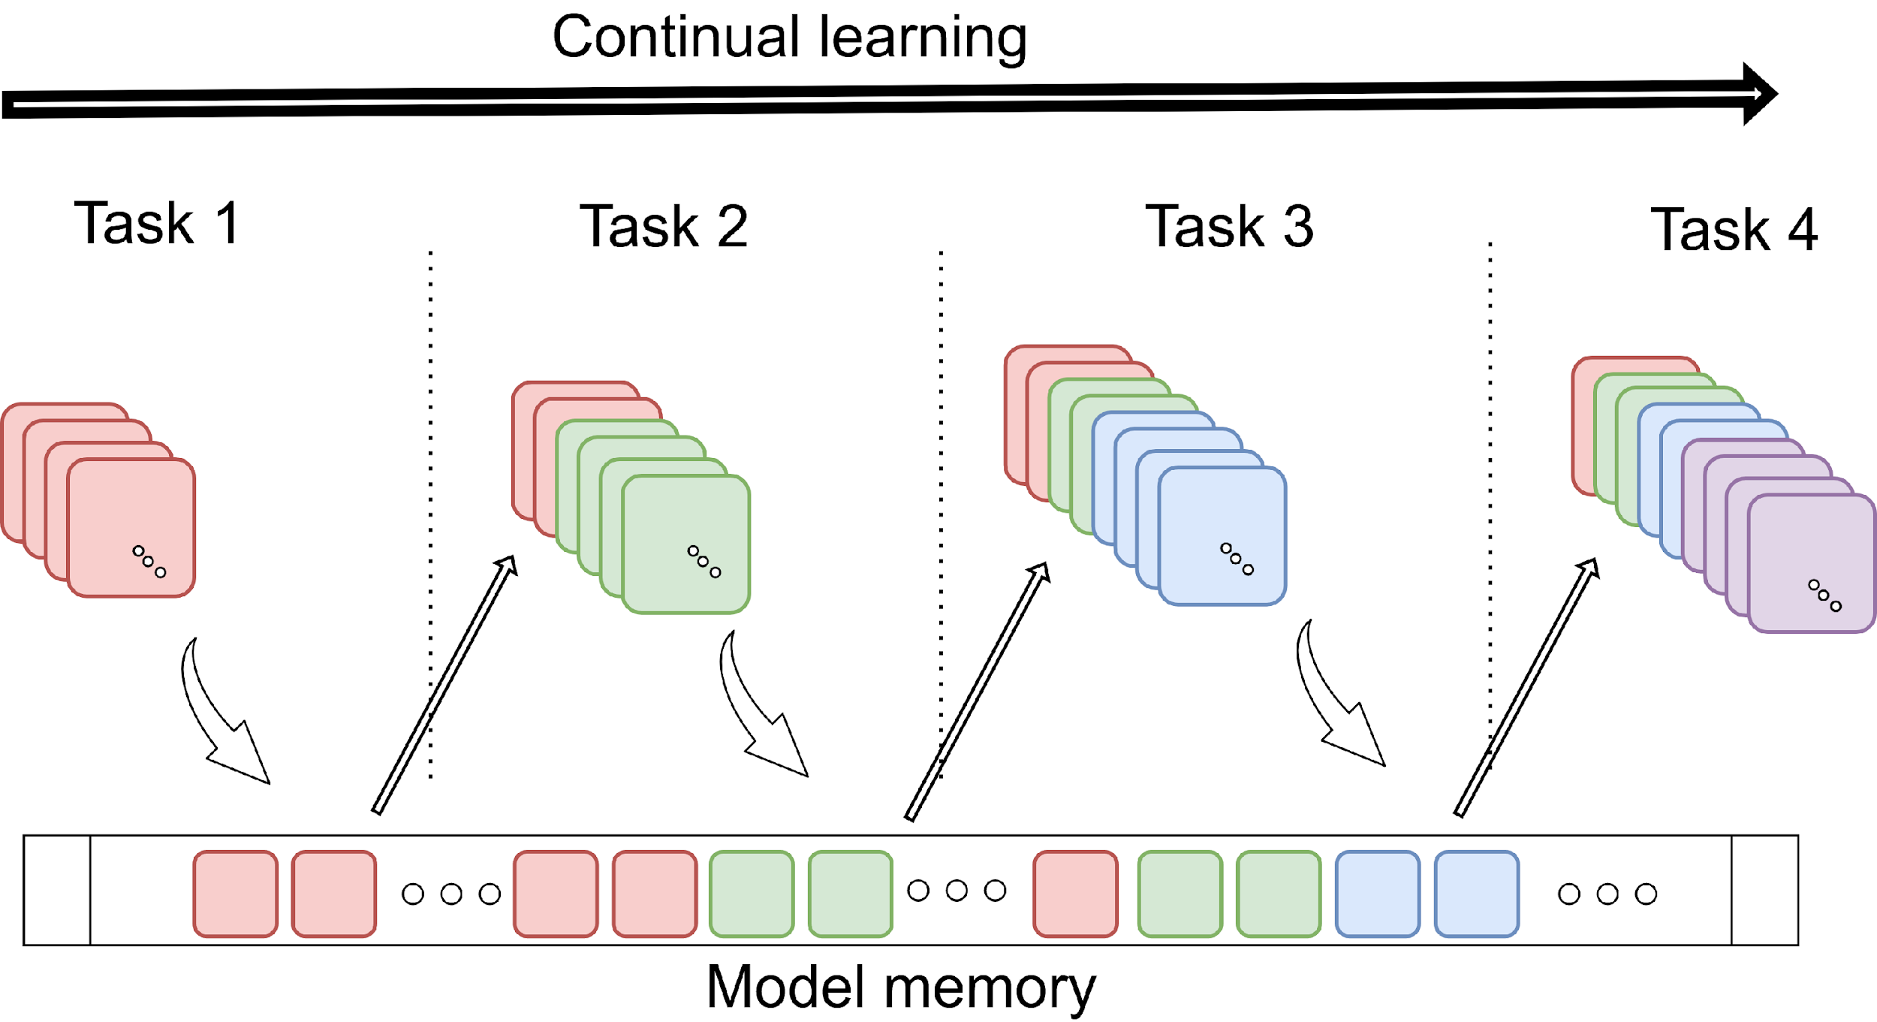
Replay methods :
Rehearsal : (iCaRL)
Replay buffer
Notes:
First of all replay method. All these method rely on using a replay buffer to store samples or pseudo samples from previous tasks. The model is periodically retrained on these sample in order to tackle catastrophic forgetting.
in practice, the learner has a total budget of M memory locations. The size of this buffer impacts directly the performance of the model, as using a buffer of infinite size would be equivalent to train the model of the joint distribution of all taks, which is, as we will see later, the soft upper bound of this method.
iCaRL is one of these models, that selects and stores in its replay buffer a subset of exemplar PER CLASS of a task, closest to the feature mean of each class.
During training, let’s say for class T_n, the estimated loss on new classes is minimized, along with the distillation loss between targets obtained from previous model predictions and current model predictions on the previously learned classes.
That means that, before training on a new Task, the model predicts the output for every sample of the buffer, that will be used later in a supervised-way to induce the model not to get to far from its old itself on previous prediction.

Slide 11
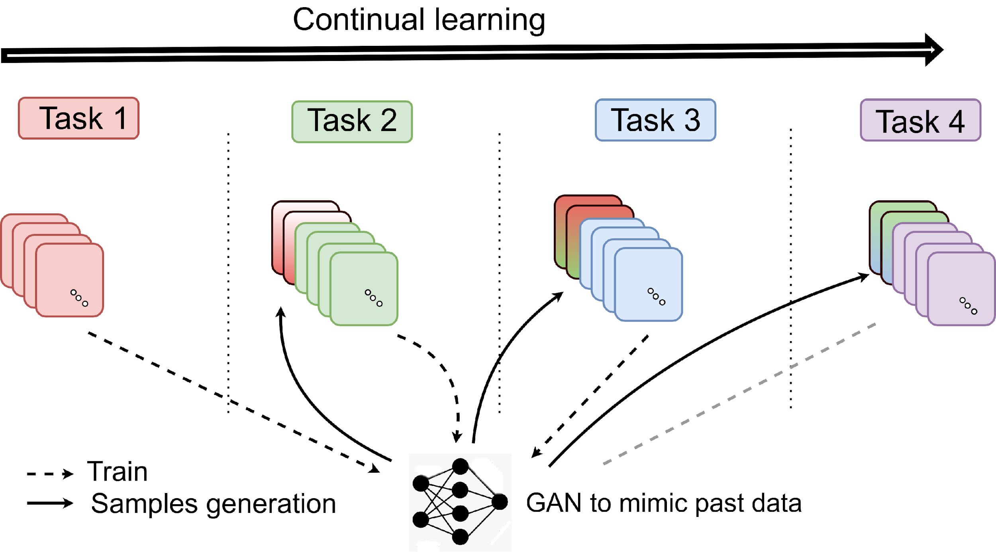
Replay methods :
Pseudo-Rehearsal :
Notes:
The second type of replay-based methods is the one that relies on the use of a generative model to generate pseudo-sample based on previously data during sequential training.
Apart from that, the learning pipeline is pretty the same from rehearsal based model such as iCaRL.
Sadly, none of the compared model on this study is based on that method, we won’t develop on that method in this presentation.

Slide 12
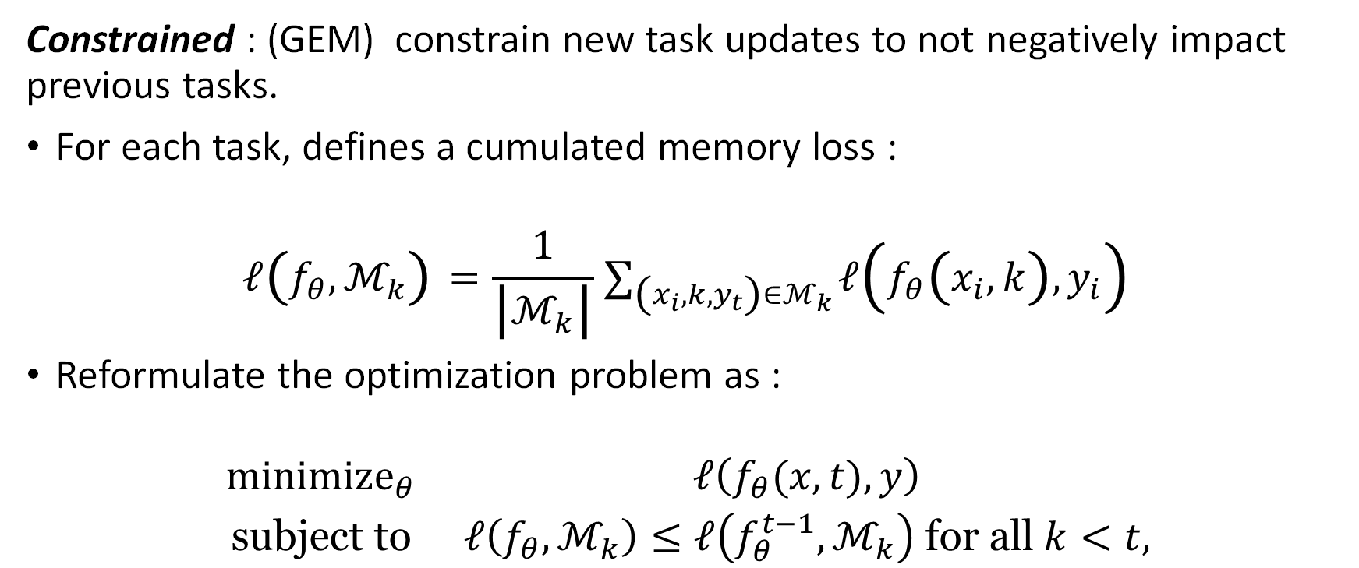
Replay methods :
Notes:
Still in the replay methods, the last section is on model based using constraint during learning, Irina already talked about that. the key idea is to only constrain new task updates to not interfere with previous tasks.
we consider predictors f parameterized by theta, and define the loss at the memories from the k-th task as follow :
Obviously we wont try to minimize that cumulated loss at the current example, but will cosntraint the current loss instead. This formulation is equivalent to what Irina introduced as a condition on the sign of a scalar product between partial derivates of the two losses. These are just two ways todescribe the problem.

Slide 13
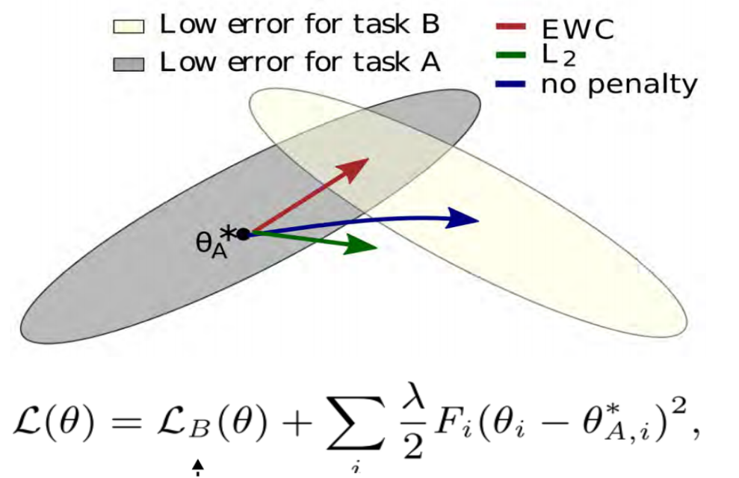
Regularization-based methods
Prior-focused : (EWC, IMM, SI) Goal : reducing the plasticity of weights that are vital to previously learned tasks.
Estimate a distribution over model parameters using previous tasks and use it as prior when learning a new task. Penalize changes to parameters that would have been away from that prior distribution.
More info on Irina’s slides.
Notes:
estimate a distribution over the model parameters (Gaussian whatever…), used as prior when learning from new data. This is done by intervening on the loss by adding a term proportial to a custom distance between the computed value of the parameter and its prior mean.
However, the success of this method depends on the new task data. Somehow, how close a new task is related to a prior task, will determine how close will be the estimated prior distribution from the computed value.

Slide 14
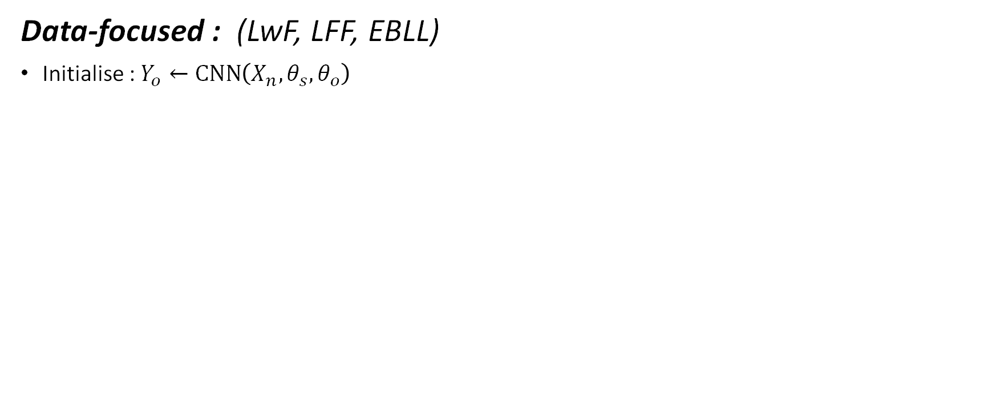
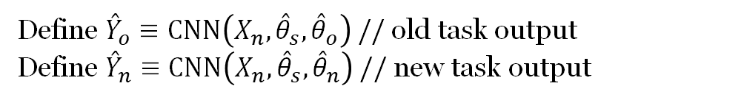
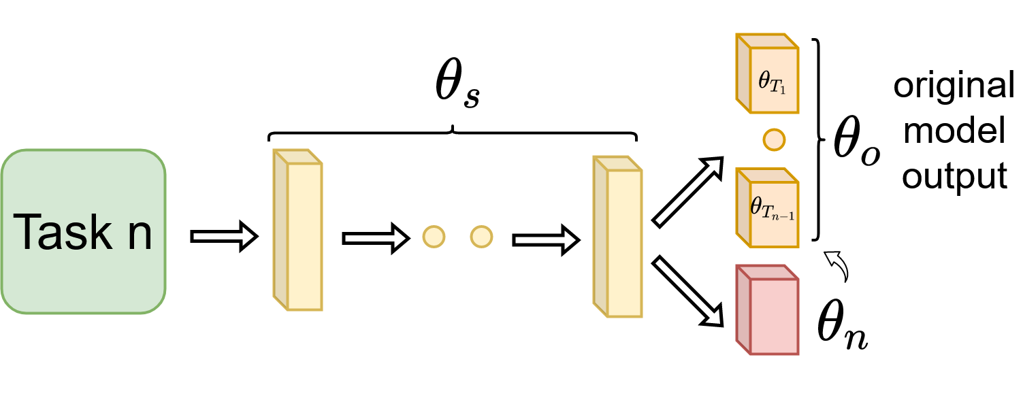
Regularization-based methods
inspired by Z. Li and D. Hoiem, “Learning without forgetting,”
Notes:
In the general case, These model are multi-headed : They share a set of parameter theta s but also have a specific set of parameters for computing the output for each task.(Orange layer) : output head for previous tasks 0 to n-1 ( not useful for inference of the task n)
Init : compute output with old params (theta_s and theta_o) for new data Xn.
The loss contains as usual a estimation loss a regularization term but also a distillation loss between the prediction of the previous model output for task n data,
Somehow, theta_0 act as at temporal counterweight that keep tracks of the old model parameters, optimal for previous tasks. It maintain some stability along training while letting a certain degree of plasticity necessary for learning a new task n thanks to the set of param theta_n.
The loss encourages the model to keep similar predictions on old task head that before the learning.

Slide 15
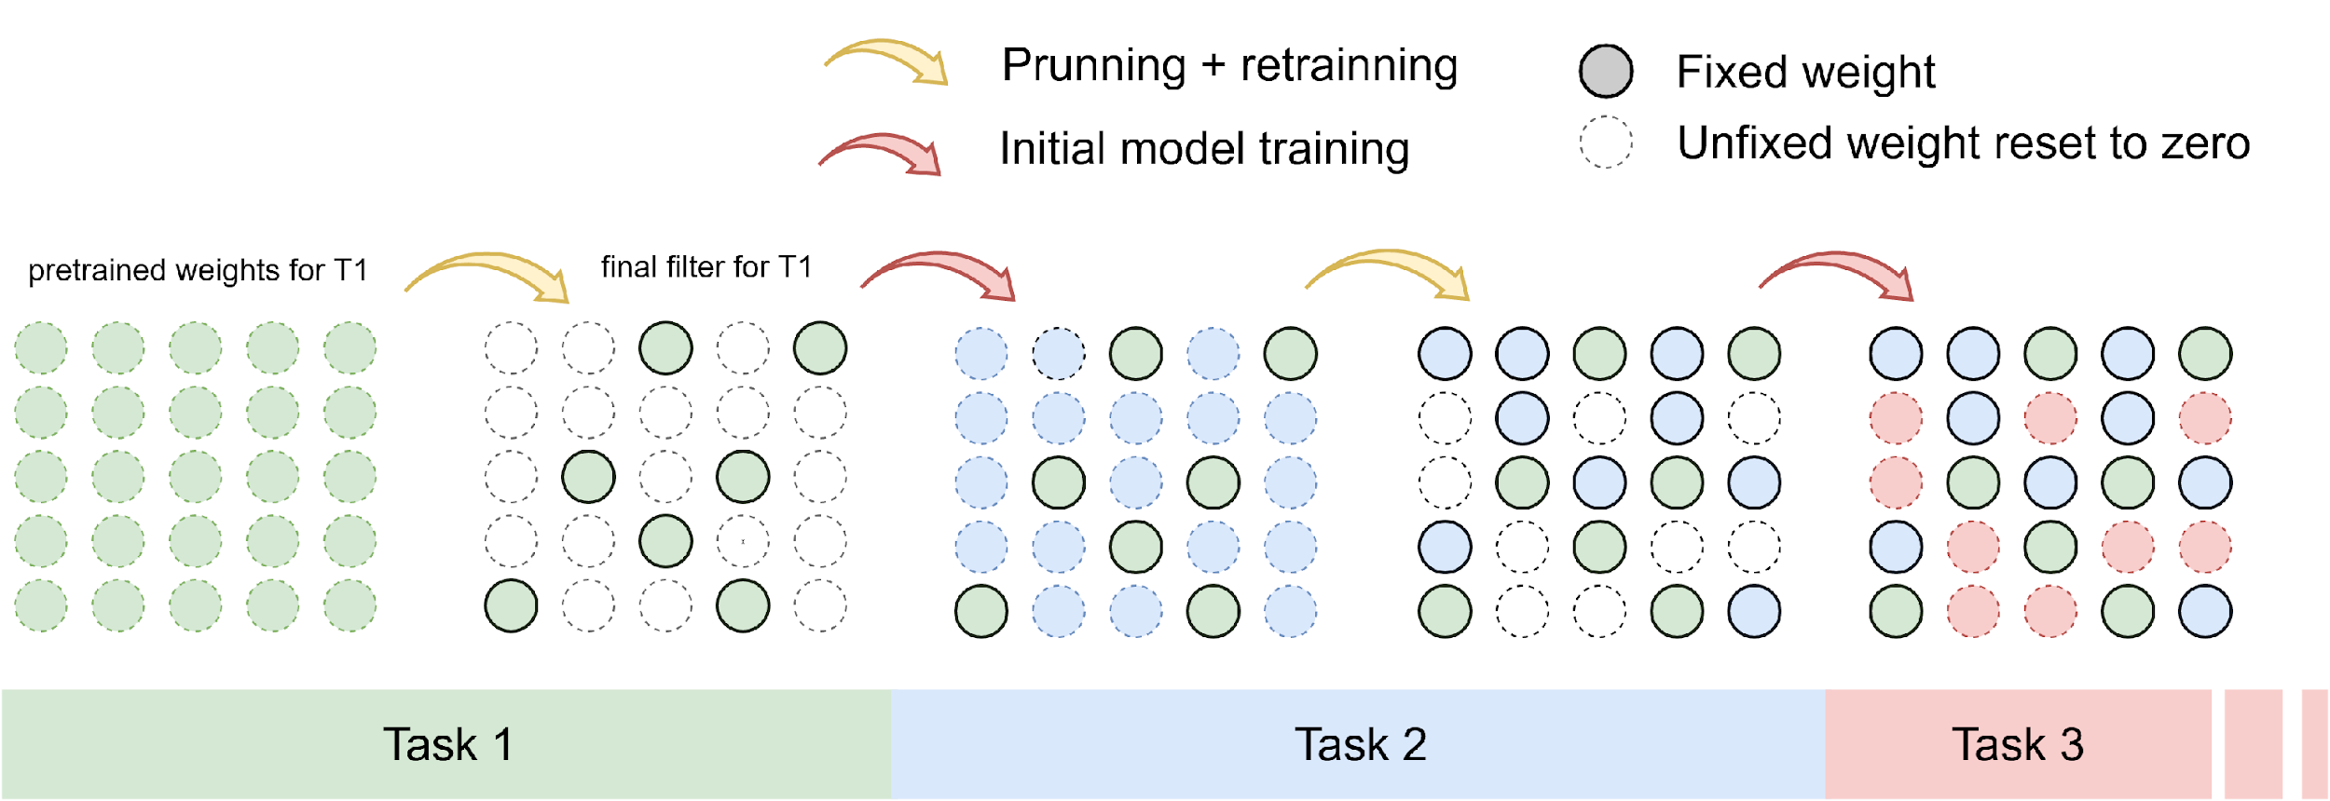
Parameter isolation-based methods
Fixed-network : (PackNet)
Inspired by A. Mallya and S. Lazebnik, “Packnet: Adding multiple tasks to a single network by iterative pruning,”
Notes:
Let's look into PackNet Parameter isolation-based methods. The idea behind this class of approaches is to dedicate a part of the architecture / weights to a specific task.
The number of tasks and parameters are set before training phase. They only allow a fixed percentage of eligible weights for each task.
At test time, appropriate masks are applied depending on the selected task so as to replicate filters learned for the respective tasks.
Pros, We avoid catastrofic forgetting, I.e performance decrease for task
Cons, no transfer learning between tasks or positive backward learning.
For an infinite number of task, you'll need an infinite number of weights.
HAT is another exemple of a parameter isolation-based methods that relies on an attention mask but won’t be detailled here.

Slide 16
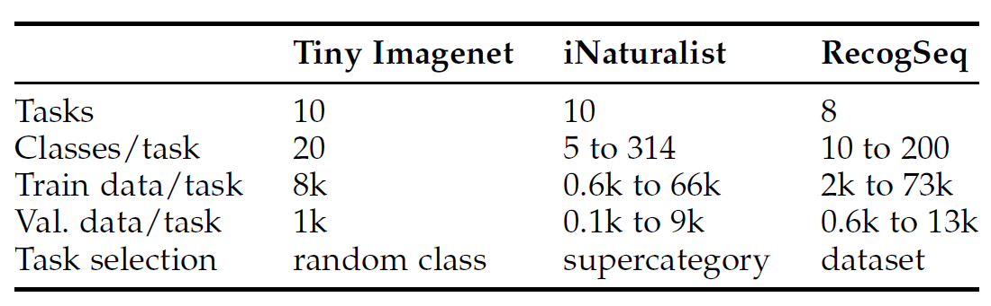
Experiments
Experimental Setup : 3 datasets : Tiny ImageNet, iNaturalist and RecogSeq
Balanced
Unbalanced
Notes:
Tiny ImageNet, classic DS, balanced class, all tasks are roughly similar in terms of difficulty, size, and distribution, making the interpretation of the results easier. A good baseline to compart method performance, before introducing any input distribution bias. all tasks are roughly similar in terms of difficulty, size, and distribution, making the interpretation of the results easier in the first time.
Then the authors whanted to analyse the impact of unbalanced dataset with the two following :
iNaturalist [84], which aims for a more real-world setting with a large number of fine-grained categories and highly imbalanced classes. So, some task has a lot of class, and some other as little as 5 classes.
RecogSeq, 8 highly diverse recognition tasks (classification of objects, actions and scenes, going from flowers, scenes, birds and cars, to aircrafts, actions, letters and digits. )

Slide 17
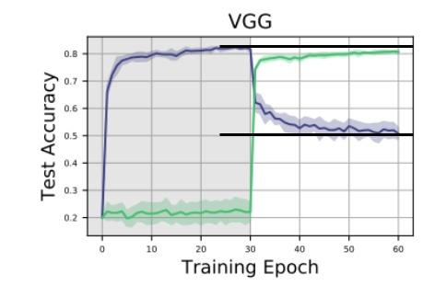
Experiments
Evaluation Metrics : accuracy and forgetting after each task
Forgetting metric
Notes:
forgetting per task: difference between the expectation of acquired knowledge of a task, i.e. the accuracy when we first learned a task, and the accuracy obtained after training one or more additional tasks.

Slide 18
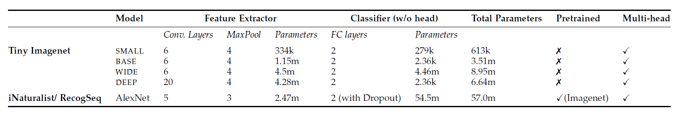
Experiments
- Model used: SMALL, BASE, WIDE, DEEP and AlexNet
- Baselines : each method is compared to two baseline :
Finetuning : starts from the previous task model and perform SGD on the new task.
Joint distribution : consider all task as part of one single dataset simultaneously.
Notes:
we evaluate accuracy and forgetting per task, after training each task
The SMALL, BASE, WIDE, DEEP models are based on a VGG configuration, but with less parameters due to the small image size
Finetuning :
Joint distribution : that violates the continual Learning setup. This baseline provides a target reference. Indeed CL-based can’t be better theoretically as their suffer from data retention imposed by the CL paradigm.

Slide 19
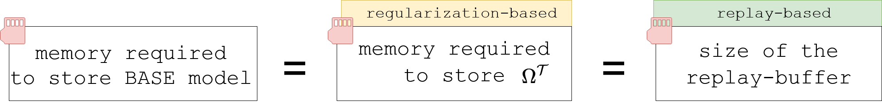
Experiments : compare like with like
Memory allocation :
Computation power :
One limit of that paper : some methods rely on more computation that others.
Notes:
One important point in that study is to find a way to put all methods on an equals footing them on an equal footing regarding computing power and memory allocation.
However as all models rely on very distinct method be it on nearest-neightbors for iCaRL, on the storage of previous sample outputs for LwF, it is pretty to ensure that every model will be given the same ressource.
How to fix the replay buffer size of Replay-based methods. That’s an important questions as as we discuss previously will have a direct impact on its performances. The more we increased the replay-buffer size, the closer we get to a framework of classical learning with all the data available at any tme.
Regarding computation power or infering time, this is one of the limit of that paper, as some model such as iCaRL relies on very uneffective algorithm, neirest neighbors in that case. Making it not scalable for very very large dataset.

Slide 20
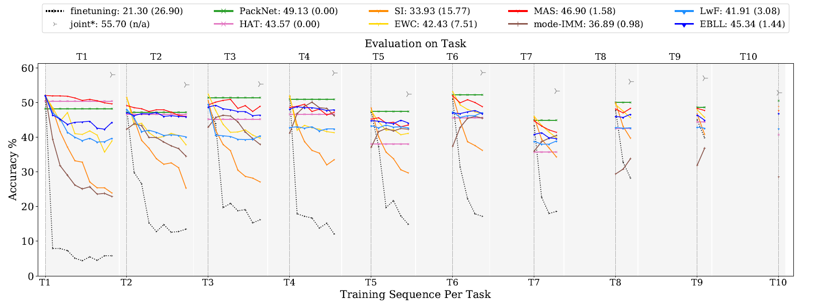
Tiny Imagenet :
Results : Parameter isolation and regularization-based methods (BASE model)
Notes:
General observations: The legends shows average final accuracy and in brackets, the average forgetting. ( the higher this score is, the more the model is forgetting during training, note that a negative score is possible leveraging backward learning possibilities.
As a reference, it is relevant to highlight the soft upper bound obtained when training all tasks jointly, as part of a single distribution.
As expected, the classic SGD model (namely finetuning) suffer very quickly from catastrophic forgetting as soon as a new task is added, performance drops, resulting in poor average accuracy of only 21.30% and 26.90% average forgetting
With 49.13% average accuracy, PackNet shows highest overall performance after training all tasks. As the task specific sub model is fixed after training, its normal to see no variation along multitask training. However, just after learning new tasks, due to compression PackNet only has a fraction of the total model capacity available. Therefore, if we could zoom in, just after training, we could see that its performce is a bit worse on new tasks compared to other methods that would take profit of all te model capacity.

Slide 21
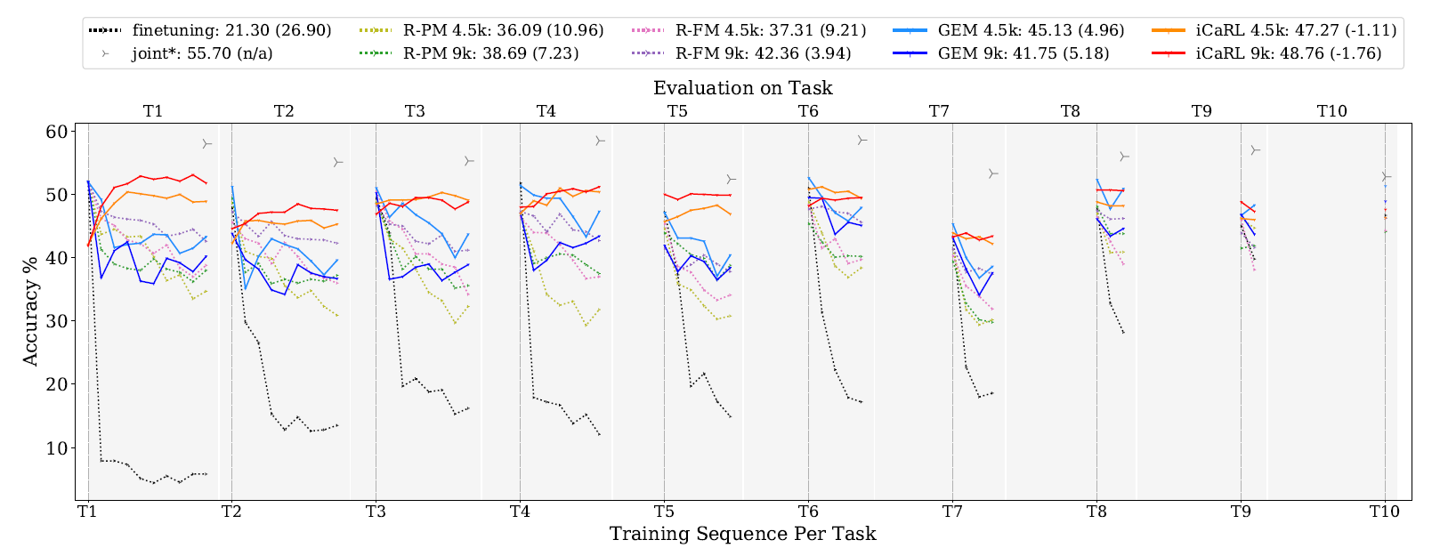
Tiny Imagenet :
Results : replay methods (BASE model)
Notes:
MAS and iCaRL shows similar results than top of the line PackNET model.
Something really interesting, is how both iCaRL models are improving thier performances on previous tasks along training new tasks. backward transfer is something pretty unusual but can be partly explained by the iCaRL model that relies on nearest neightbors.

Slide 22
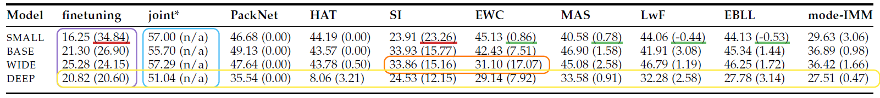
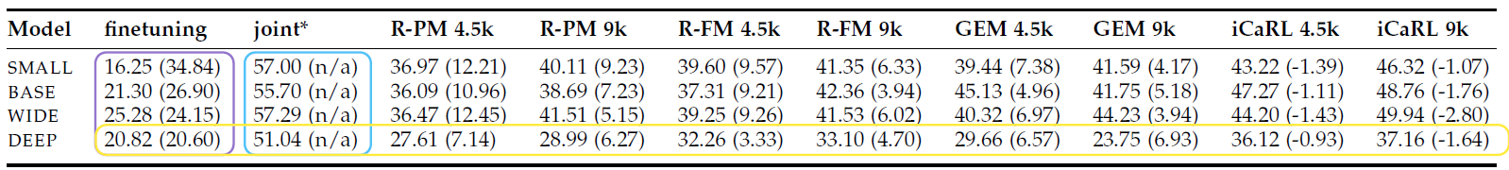
Experiments
Impact of model capacity :
Notes:
As we saw, iCaRL model are the only one that shows sign of backward transfer, while getting results comparable with top of the line model suck as PackNet.
Joint training results on the DEEP network (blue box) are inferior compared to shallower networks, implying the deep architecture to be less suited to accumulate all knowledge from the task sequence.Hence, extending the BASE model with additional convolutional layers results in lower performance.
We can conclude that (too) deep model architectures do not provide a good match with the continual learning setup : this is purely hypothetic, may they lack of plasticity comes from the use of unnecessary convolutionnal NN layers.

Slide 23
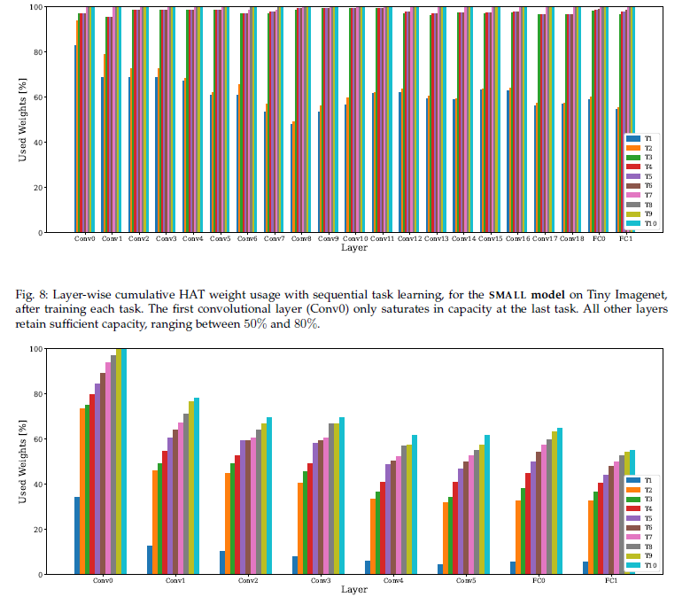
Experiments
Small
Impact of model capacity :
Deep
Notes:
Proofs of DEEP model lack of plasticity with this Layer-wise cumulative HAT weight usage
most of the weights are used as soon as the 3rd task is learned, there is no room left to fit specific sub-networks for future tasks, the DEEP model lacks plasticity.

Slide 24
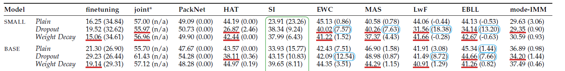
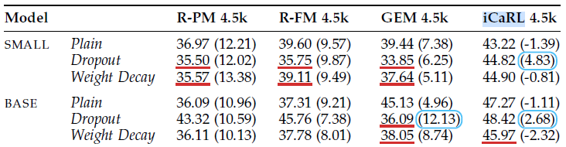
Experiments
Effect of regularization : Droupout and Weight Decay (L2-regularization)
Notes:
They found some proof of overfitting -> authors proposed to look at some usual regularization method ?
Generally, both regularization methods deteriorate average accuracy and emphazise the catastrophic forgetting phenomenon.
The only improvement occcurs to SI regularization-based model, one of the least performant model of the survey. It was known to overfits its training data.

Slide 25
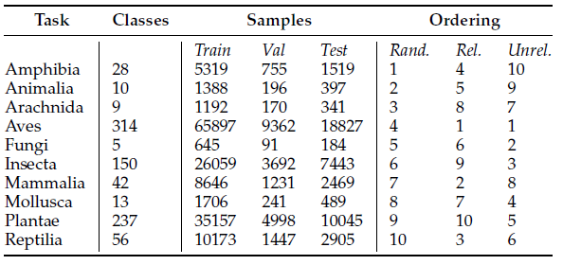
Experiments
Effect of task order:
Notes:
All models and CL methods were subject to different task oredering schemes for both balanced Tiny Imagenet and unbalanced (iNaturalist) task sequences.
Tiny Imagenet tasks were ordered at random, from hard to easy and easy to hard. The assumption was that easy-to-hard ordering would enhance performance. However, the impact of the task order seems insignificant.
In the other hand, With iNaturalist, classes are ordered by highest relatedness, lowest relatedness, and at random. Random ordering did affect the performance of some methods. This could be due to iNaturalist being unbalanced. An other ordering I would have suggested is by amount of data in each task.
Everything being said, their results would have been significant if they had done a k-fold cross validation with a t-test. We cannot conclude with the provided data.
Time for some skepticism, take this experiment with a grain of salt.
**spoilers**, task order has a small impact on results when it comes to image classification

Slide 26
Conclusion
Hyperparameter framework: a fair comparison framework compliant with the continual learning setting
Performance comparison: PackNet performs above the rest by high margin on all three datasets
Experiments with task ordering: minimal influence compared to the methods
Notes:
The parameter isolation-based method PackNet seems to have win the grandprix.
Shout-out to the article Optimization and Generalization of Regularization-Based Continual Learning. It approximates previous losses with the second-order Taylor expansion based on previously stored weights for each task

Slide 27

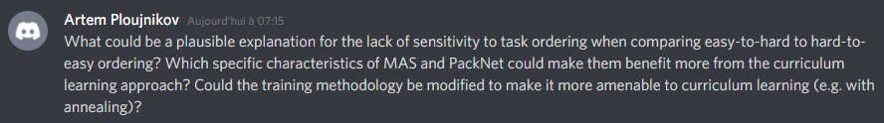
Questions :

